Slide 1

WAY TO ENTERPRISE
AWS
VTI ACADEMY
Author: duy.nguyenngoc1@vti.com.vn

Slide 2
Agenda
VM Import/Export
Migration Hub
Copyright © VTI Academy All Rights Reserved

Slide 3
VM Import/Export
Is a service that allows
  Import VM on on-premises to EC2 (Similar to AMI)
  Export from EC2 to run on on-premises
  Import disk in on-premises as an EBS Snapshot
Old
Tutorial: https://docs.aws.amazon.com/vm-import/latest/userguide/what-is-vmimport.html

Slide 4
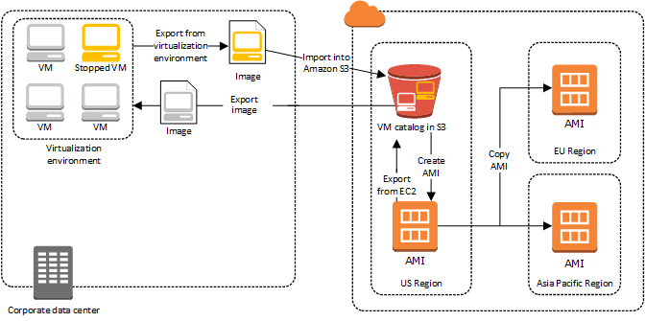
VM Import/Export
Usecases
  Migrate existing application to EC2
    No need to configure or reinstall any software, …
  Push to Cloud to avoid disaster
Image import & export

Slide 5
VM Import/Export
Demo
  https://www.youtube.com/watch?v=kfrb5_6Pe_Y

Slide 6
Assignment
  Self-practice

Slide 7
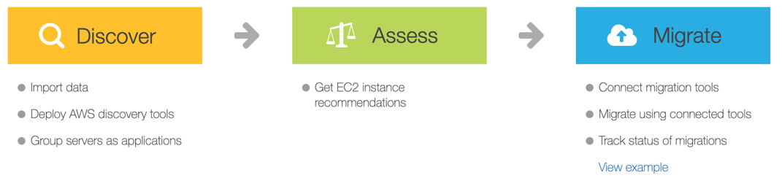
Migration Hub
Providing a single place to
  Discovery of server information running on on-premises 🡺 suggest EC2 recommendation configuration suitable for running on-premises server when migrating to AWS
  Migration server, database running on-premises to AWS
Tutorial: https://docs.aws.amazon.com/migrationhub/latest/ug/whatishub.html

Slide 8
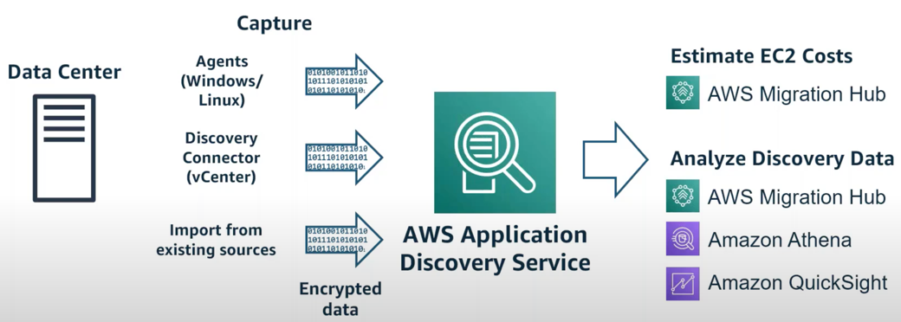
Migration Hub
Flow
  Discovery of server information running on on-premises
    Step 1: Download & deploy discovery tool (discovery connector/Agent) on on-premises server
    Step 2: Use Application Discovery Service to collect information in the server
    Step 3: Migration Hub will read data from Application Discovery Service and display it on console for User

Slide 9
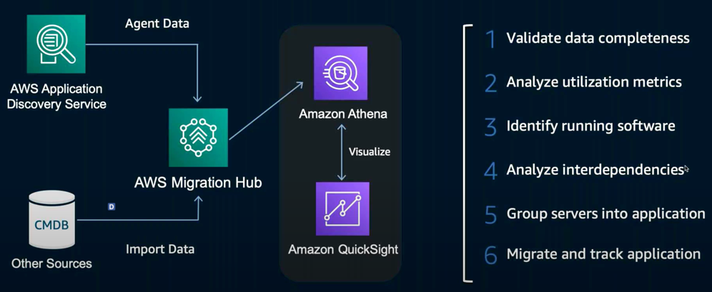
Migration Hub
    Using Application Discovery Service
    Tools
      Agentless Discovery Connector
        Only installable on Vmware
        Capture only information about VMware
      Application Discovery Agent
        Installable on Vmware or physical servers
        Capture technical specifications, system performance, network dependencies, process information
https://docs.aws.amazon.com/application-discovery/latest/userguide/what-is-appdiscovery.html

Slide 10
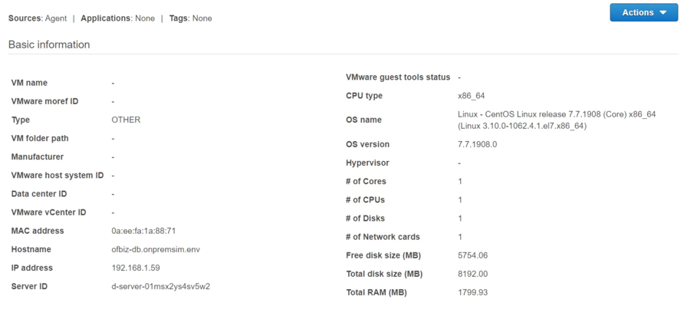
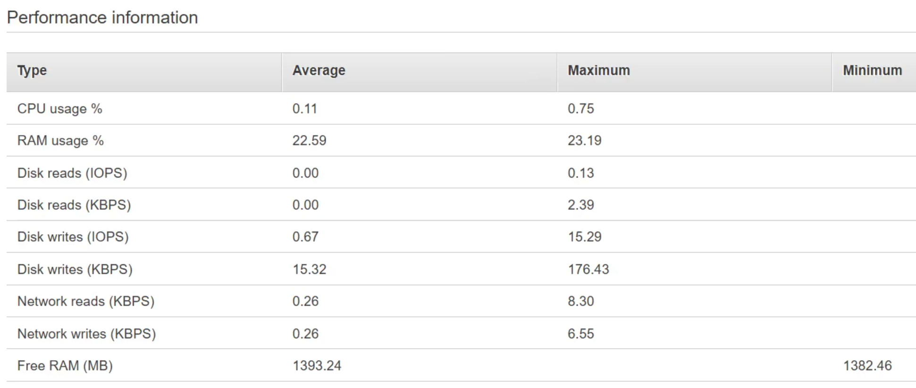
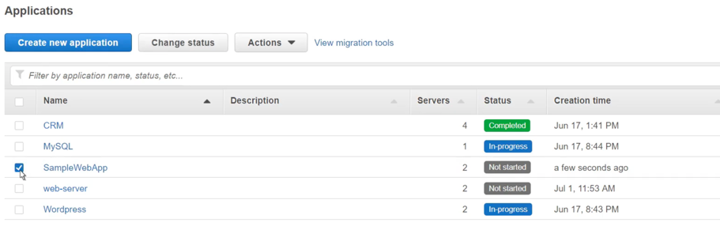
Migration Hub
Server information
Can group servers into an application

Slide 11
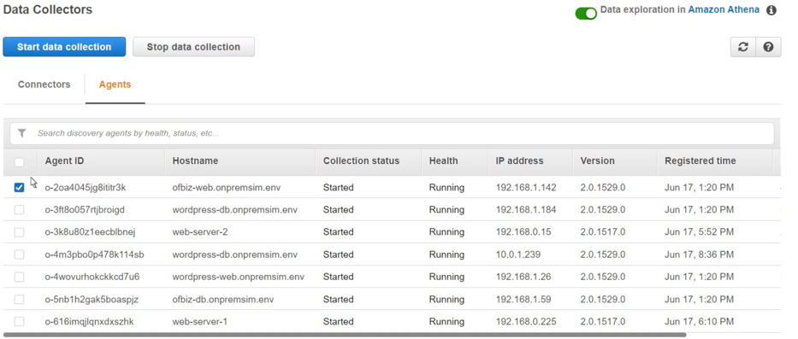
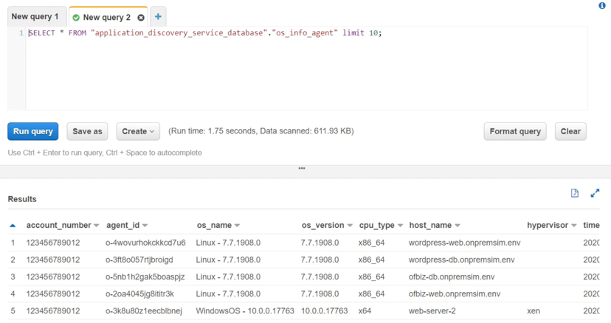
Migration Hub
    Data Collector
      Save collected data on S3 🡺 use Athena, QuickSight to analyze information on the server

Slide 12
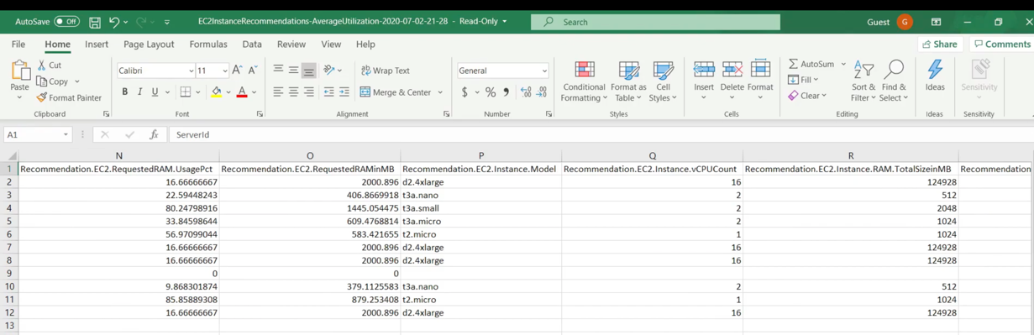
Migration Hub
    EC2 Instance Recommendations
      AWS will rely on the data & configuration of the server to suggest EC2 configuration suitable for the server when migrating to EC2
      AWS will export the suitable configuration to an excel file

Slide 13
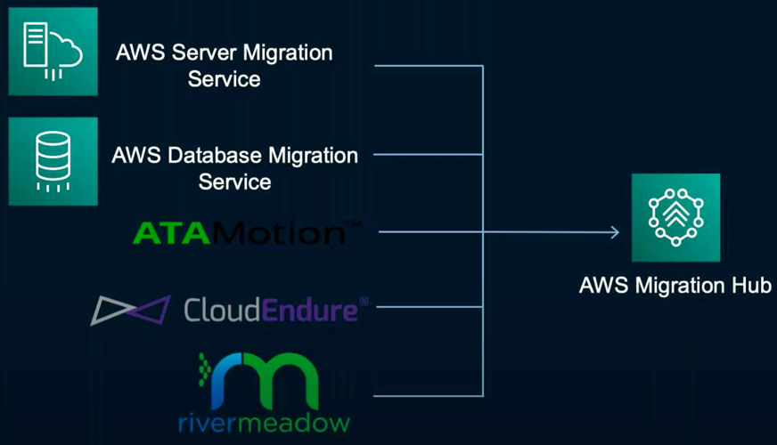
Migration Hub
  Migration server, database running on-premises to AWS
    Server: Server Migration Service (SMS), Application Migration Service (MGN)
    Database: Database Migration Service (DMS)

Slide 14
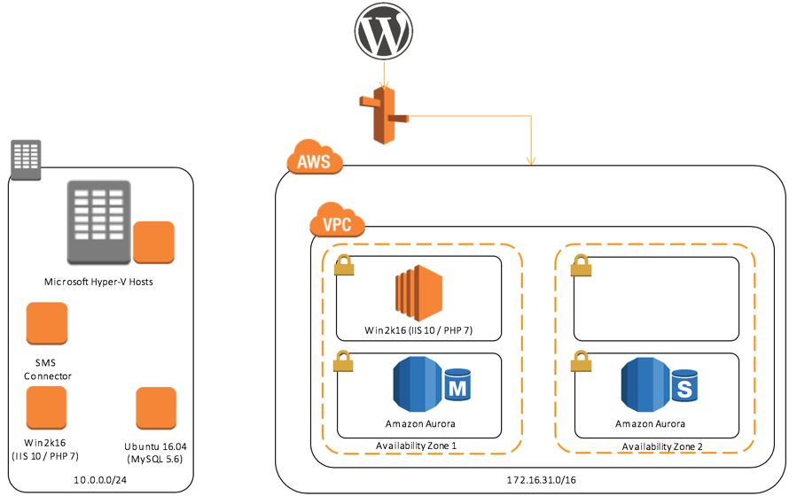
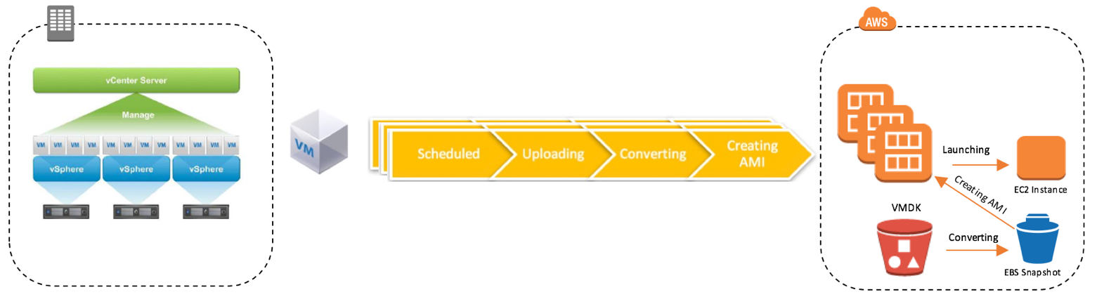
Migration Hub
    Server Migration Service (SMS)
      Automatically migrate servers in on-premises or other cloud to AWS
      Support VMware, Microsoft Hyper-V, Azure virtual machines
      Instead of VM import/export
      Tutorial: Link
SMS Flow
SMS + DMS

Slide 15
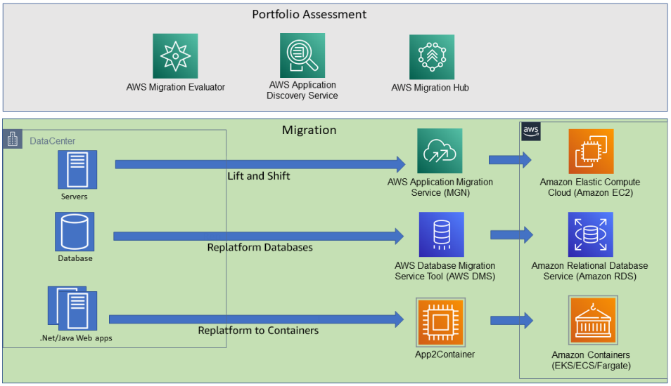
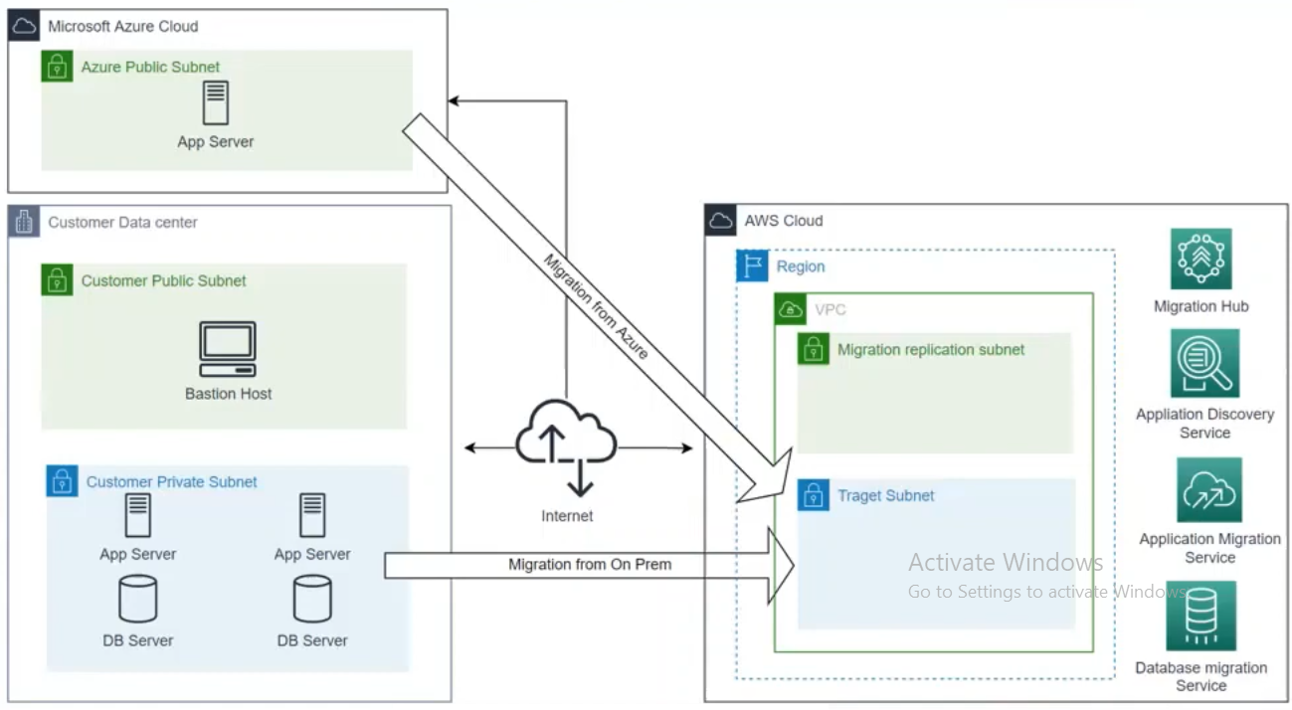
Migration Hub
    Application Migration Service (MGN)
      Automatically migrate servers, VPC, … in on-premises or other cloud to AWS (Similar to SMS)
      Support physical server, VMware, Microsoft Hyper-V, VPC, …
      Instead of Server Migration Service
      Tutorial: Link
MGN + DMS

Slide 16
Migration Hub
Demo
  Migration Hub: https://www.youtube.com/watch?v=T4AqU1lXI0s
  Application Discovery Service: https://www.youtube.com/watch?v=aq6ohCf6PBo
  Server Migration Service: https://www.youtube.com/watch?v=_SpRpC2Ez9c
  Application Migration Service: https://www.youtube.com/watch?v=-s_6wyqIBys

Slide 17
Q & A
Copyright © VTI Academy All Rights Reserved

